Slide 1
Lesson 2.1
Introduction to jQuery

Slide 2
Learning Outcomes
Define jQuery, explain its advantages and disadvantages
Setup jQuery in your web project
Use basic jQuery syntax
Explain jQuery, window.jQuery, $, window.$
Use jQuery methods and effects

Slide 3
jQuery Basics
Modern web applications interact heavily with the DOM.
Add, edit, and delete DOM elements to deliver an interactive user experience.
Browsers have basic support for navigating through the DOM tree.
Examples: getElementById(), getElementsByClassName()
jQuery is a fast and concise JavaScript library that simplifies HTML document traversing, event handling, animating, and Ajax interactions for rapid web development.
What is a library?
JavaScript code that somebody else has written.
You can use libraries in your application, often for free.
Libraries can also be called “plug-ins” or “external modules”.

Slide 4
jQuery Basics
jQuery is not a new programming language.
jQuery is a library written in JavaScript that provides powerful functions for working with the DOM more efficiently.
jQuery features:
DOM selection: jQuery provides selectors to retrieve DOM elements based on various criteria.
DOM manipulation: you can manipulate DOM elements using various built-in jQuery functions.
Special effects: easily apply special effects to DOM elements like fade-in, fade-out, sliding, animation.
Events: jQuery functions handle DOM events.
AJAX: jQuery functions use Asynchronous JavaScript and XML (AJAX) to load data from servers without reloading the whole page.
Cross-browser support.

Slide 5
jQuery Basics
Benefits of jQuery:
Easy to learn – you already know JavaScript!
“Write less, do more.”
API documentation: https://api.jquery.com/
Better performance.
Standardization.

Slide 6
jQuery Library Integration
How do I integrate the jQuery library into my application?
Two available methods:
Download the jQuery library and integrate the file into your application.
Include jQuery from a CDN (Content Delivery Network) so that it will be loaded by the browser at run-time. Requires an internet connection!

Slide 7
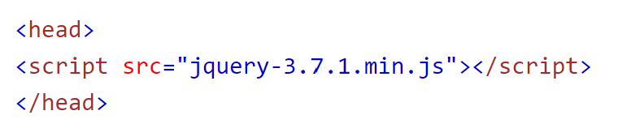
How to Download jQuery
Go to https://jquery.com/download/
Download the proper version:
Production version - this is for your live website because it has been minified and compressed.
Development version - this is for testing and development (uncompressed and readable code).
Place the JavaScript file somewhere in your application’s directory.
Insert a reference to the jQuery library file using the HTML <script> tag inside the <head> section of each page that will be using the library.
Notes:
jQuery_Integration_Example

Slide 8
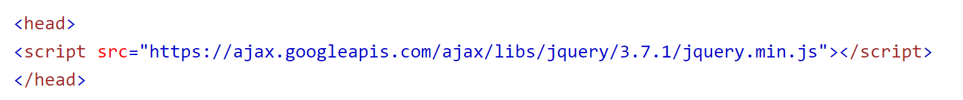
How to Include jQuery from a CDN
Find a jQuery CDN from the list provided:
https://jquery.com/download/#jquery-cdn
Insert a reference to the jQuery library hosted by the CDN using the HTML <script> tag inside the <head> section of each page that will be using the library.
Notes:
jQuery_Integration_Example

Slide 9
Pros and Cons: jQuery Local Download
Pros:
Availability:
The library is always available and not dependent on external servers.
This is particularly useful in environments without internet access or with restricted access.
Customization:
You can modify the library if necessary, tailor it to your specific needs, or integrate it with other local scripts.
Version control:
Ensures that you are using the exact version you have tested with your application, avoiding any potential issues with updates or changes.
Cons:
Load time:
Slightly longer load times since the browser needs to download the jQuery file from your server every time.
Bandwidth:
Uses your server's bandwidth, which can be an issue if you have many visitors or limited resources.
Caching:
Each visitor will need to download your version of jQuery, even if they have a cached version from another site.

Slide 10
Pros and Cons: jQuery from a CDN
Pros:
Performance:
CDNs are optimized for delivery and are often faster than serving from your own server.
Caching:
Browsers often cache files from popular CDNs.
If a user has already visited another site using the same CDN and version of jQuery, they won’t need to download it again.
Reliability:
CDNs are highly reliable with redundancy and failover mechanisms in place to ensure high availability.
Bandwidth savings:
Offloads the bandwidth usage to the CDN, which can be beneficial for sites with limited resources.
Cons:
Dependency:
You are dependent on the availability of the CDN.
If the CDN goes down, your site might face issues.
Security:
There is a potential risk if the CDN gets compromised, though this is rare.
Customization:
You cannot modify the library.
You must use the library as provided by the CDN.

Slide 11
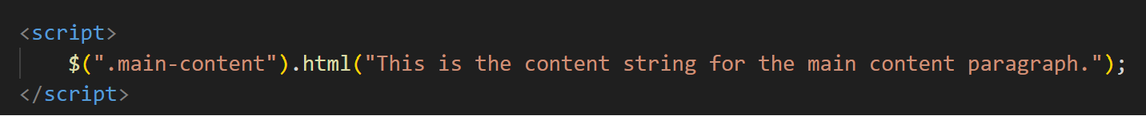
jQuery Example
What is happening in this example?
$ character is a shorthand for telling the browser that this is a jQuery function.
The function takes a single argument called the jQuery selector.
The selector wants to find all elements with the class ‘main-content’.
Once we have the matching elements, use the ‘html’ method to inject content.

Slide 12
jQuery Example continued
This is like using the document.innerHTML property, with some differences:
jQuery is usually faster.
jQuery returns an array of elements that match a selector (not just a single element). Therefore, you can make changes to multiple DOM elements at the same time.
jQuery returns a jQuery element, not a DOM element. The DOM element is held inside the jQuery element. This gives you lots of extra tools.
jQuery uses CSS selectors.

Slide 13
jQuery() Function
When the jQuery library has been loaded in a browser, it adds the global function named jQuery().
Global scope means scope of the “window”.
$ is an alias of jQuery function, so you can also use $() as a short form of jQuery().
The jQuery() function can be called anywhere in your webpage using any of the following:
window.jQuery
window.$
jQuery
$
Example: open a webpage with the jQuery library installed and type these function names into the console. What happens?

Slide 14
jQuery Syntax
jQuery allows you to select (“query”) HTML elements and perform “actions” on them. All jQuery functions have the same basic pattern:
$(selector).action();
Syntax:
Dollar sign ($) is shorthand for “this is jQuery”.
The “selector” means to find these element(s) in the DOM.
The “action” is a jQuery method (i.e. function) that lets you do something to the element(s) it found.
Examples:
$(this).hide() - hides the current element
$("p").hide() - hides all <p> elements
$(".test").hide() - hides all elements with class="test“
$("#test").hide() - hides the element with id="test"

Slide 15
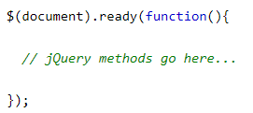
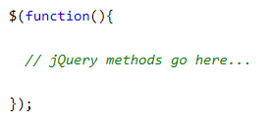
The Document Ready Event
In general, you will want to put all jQuery methods in the document ready event.
This is to prevent any jQuery code from running before the document is finished loading (“is ready”).
The ready() function detects whether a particular element is loaded or not.
The ready() function takes a callback function as a parameter. This callback function will be called once “document” is ready.

Slide 16
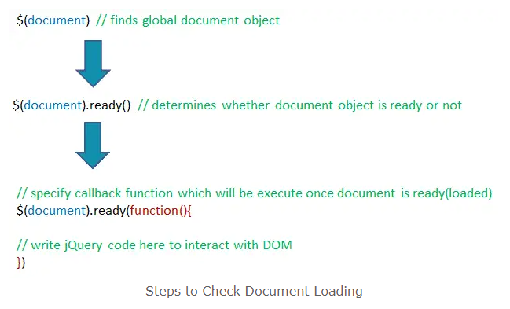
The Document Ready Event
Best practice is to wait for the document to be fully loaded before working with it.
Otherwise, some of your actions may fail if methods are run before the document is fully loaded.

Slide 17
jQuery Selectors
jQuery selectors are used to find and select HTML elements based on their name, id, classes, types, attributes, values of attributes and more.
It's based on the existing CSS Selectors as well as its own custom selectors.
All selectors in jQuery start with the dollar sign and parentheses: $()
The jQuery selector always returns an array of elements, even if it only finds a single match.
This differs from the built-in browser functions which only operate on single DOM elements.

Slide 18
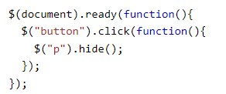
jQuery Selectors
Element selector:
Selects elements based on the element name, just like in CSS.
Example: when a user clicks on any button, all <p> elements will be hidden.

Slide 19
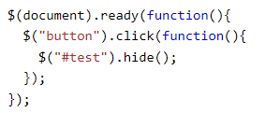
jQuery Selectors
#id selector:
Selects a specific element based on the id attribute of an HTML tag, just like in CSS.
Remember, an id should be unique within a page.
Use the #id selector when you want to find a single, unique element.
Example: when a user clicks on any button, the element with id=“test” will be hidden.

Slide 20
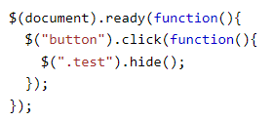
jQuery Selectors
.class selector:
Selects elements with a specific class, just like in CSS.
Example: when a user clicks on any button, all elements with class=“test” will be hidden.

Slide 21
jQuery Selectors
jQuery Selectors example
https://codepen.io/michael-dorsey/pen/GReXaWd
How do I include the jQuery library in CodePen without being able to access the <head> tag?
In a CodePen, go to Settings > JS > Add External Scripts/Pens > search for jQuery.

Slide 22
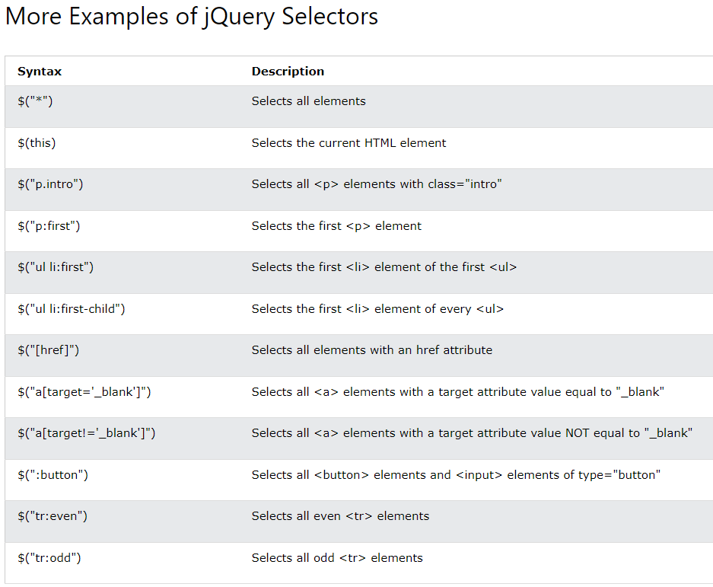
Full list of available jQuery selectors:
https://www.tutorialsteacher.com/jquery/jquery-selector-reference

Slide 23
jQuery Actions
Basic actions:
.hide() - make the matched elements disappear.
.show() - make the matched elements appear.
.text() – get or set the text contents of the matched elements.
.append() – add some new elements to the DOM as children of the matched elements.
.css() – get or set CSS properties of the matched elements.
.html() – get or set the HTML contents of the matched elements.
.val() – get or set the value of the matched elements.
Example: https://codepen.io/michael-dorsey/pen/WNqrgWP

Slide 24
Practice Activity
Download the file ‘Lesson-2.1-practice_activity.html’ from D2L > Class Resources.
Import the jQuery library into this file.
Use jQuery to make the following changes to the HTML on this page:
Hide the paragraph with id = “hideParagraph”
Change the text inside the <span></span> tags to be “I’ve been changed!”
Change the HTML inside the div with id = “targetDiv” to be the following:
<p><strong>This is a new paragraph</strong></p>
Apply the following CSS to any elements with the class = “addCSS”:
background-color: lightblue;
color: red;

Slide 25
Group Project Check-In
What did your team accomplish since our last check-in?
What will your team accomplish by the next check-in?

Slide 26
For next class
Read Lesson 2.2.
Do Learning Activities 2.2.1, 2.2.2, and 2.2.3.
Assessments Reminder:
Assignment 1 due July 25, 8:00am.
Group Project due August 22, 11:59pm.
All assessment dates have been posted in D2L.
See the “Assignments Policy” for late submission procedures.

Slide 27
References
https://www.w3schools.com/jquery/jquery_get_started.asp
https://www.tutorialsteacher.com/jquery/what-is-jquery
https://www.w3schools.com/jquery/jquery_syntax.asp
https://www.w3schools.com/jquery/jquery_selectors.asp
https://www.tutorialsteacher.com/jquery/start-using-jquery

